Slide 1
Outline
EDA - 4 or 5 slides
Preprocessing - 1 slide for each technique/group of techniques
Additional preprocessing techniques tried out - log transformations etc. ½ slides
Trianing data augmentation 1 slide
Mangerial actions
Final benchmark model - 1 slide

Slide 2
Multi-Class Classification of Liver Cirrhosis Outcomes
Ashwanth - AXR230028
Abishek - AXB220123
Damian Thomas - DXT230012 Thirunarayanan - TXR220025
Vinayak - VXS230023

Slide 3
Table of Contents
Introduction
EDA
Preprocessing & Model Building
Evaluation
ML-Flow

Slide 4
Business Context
Liver Cirrhosis Impact:
Globally significant cause of morbidity and mortality, contributing to 2.4% of global deaths in 2019.
Develops from liver scarring due to diseases like hepatitis and chronic alcoholism.
Use Cases:
Patient Selection for Transplantation: This ensures that scarce resources such as donor organs are allocated efficiently to those who are most likely to benefit.
Timing of Transplantation: This can improve patient outcomes by avoiding premature or delayed transplantations.

Slide 5
Metadata
This dataset was synthetically generated using a DL model and provided by Kaggle as a part of 2023 Playground Series competition.
No. of records
Train: 7905
Test: 5271
No. of attributes: 20
Numeric: 12
Categorical: 8
The target variable Status contains the following labels
D = 0 (Death)
C = 1 (Censored due to lost follow-up)
CL = 2 (Censored due to Liver transplant)

Slide 6
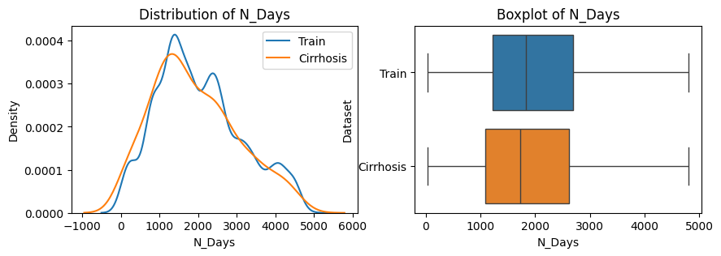
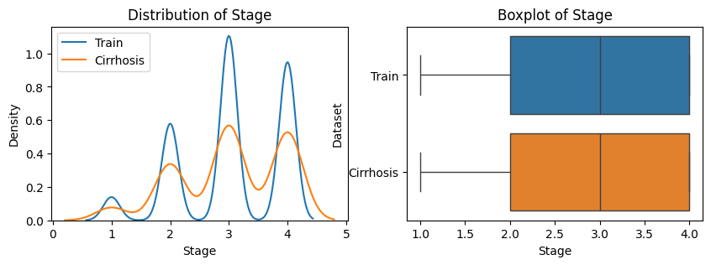
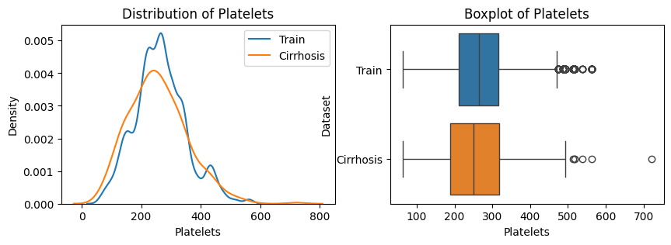
EDA - Training Data Augmentation
Firstly, we wanted to check if we could utilize the original cirrhosis dataset for modeling purposes as it would provide more data and utilizing a larger dataset for training could improve the model efficiency, so we analyzed the distributions of all the features in both to see if they were compatible and can be merged.
The visuals suggest that is viable due to their distributions being similar in nature and thus we go ahead and merge the same.

Slide 7
EDA - Training Data Augmentation
Checked the compatibility of original cirrhosis dataset for modeling purposes.
Analyze feature distributions in both datasets.
Merge datasets if distributions are similar.

Slide 8
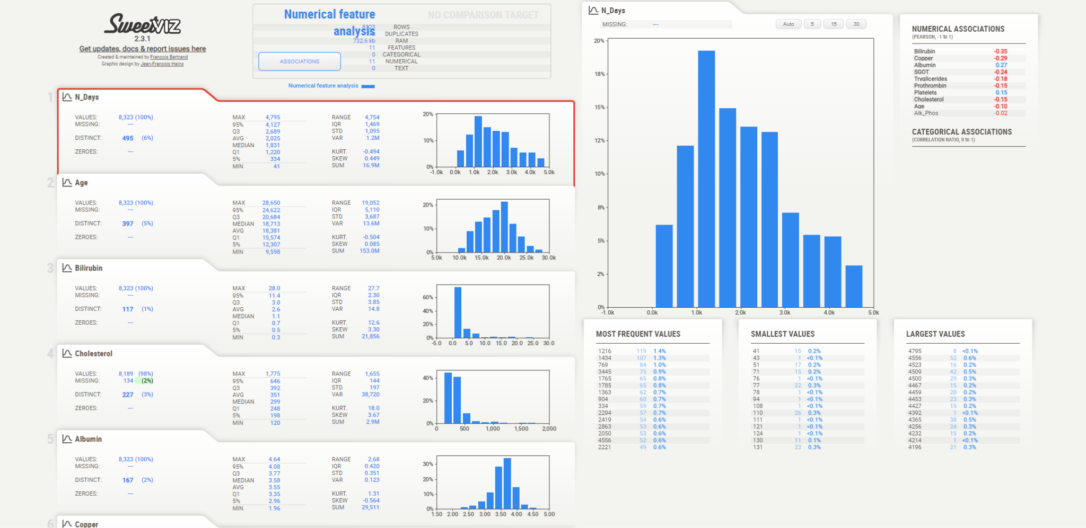
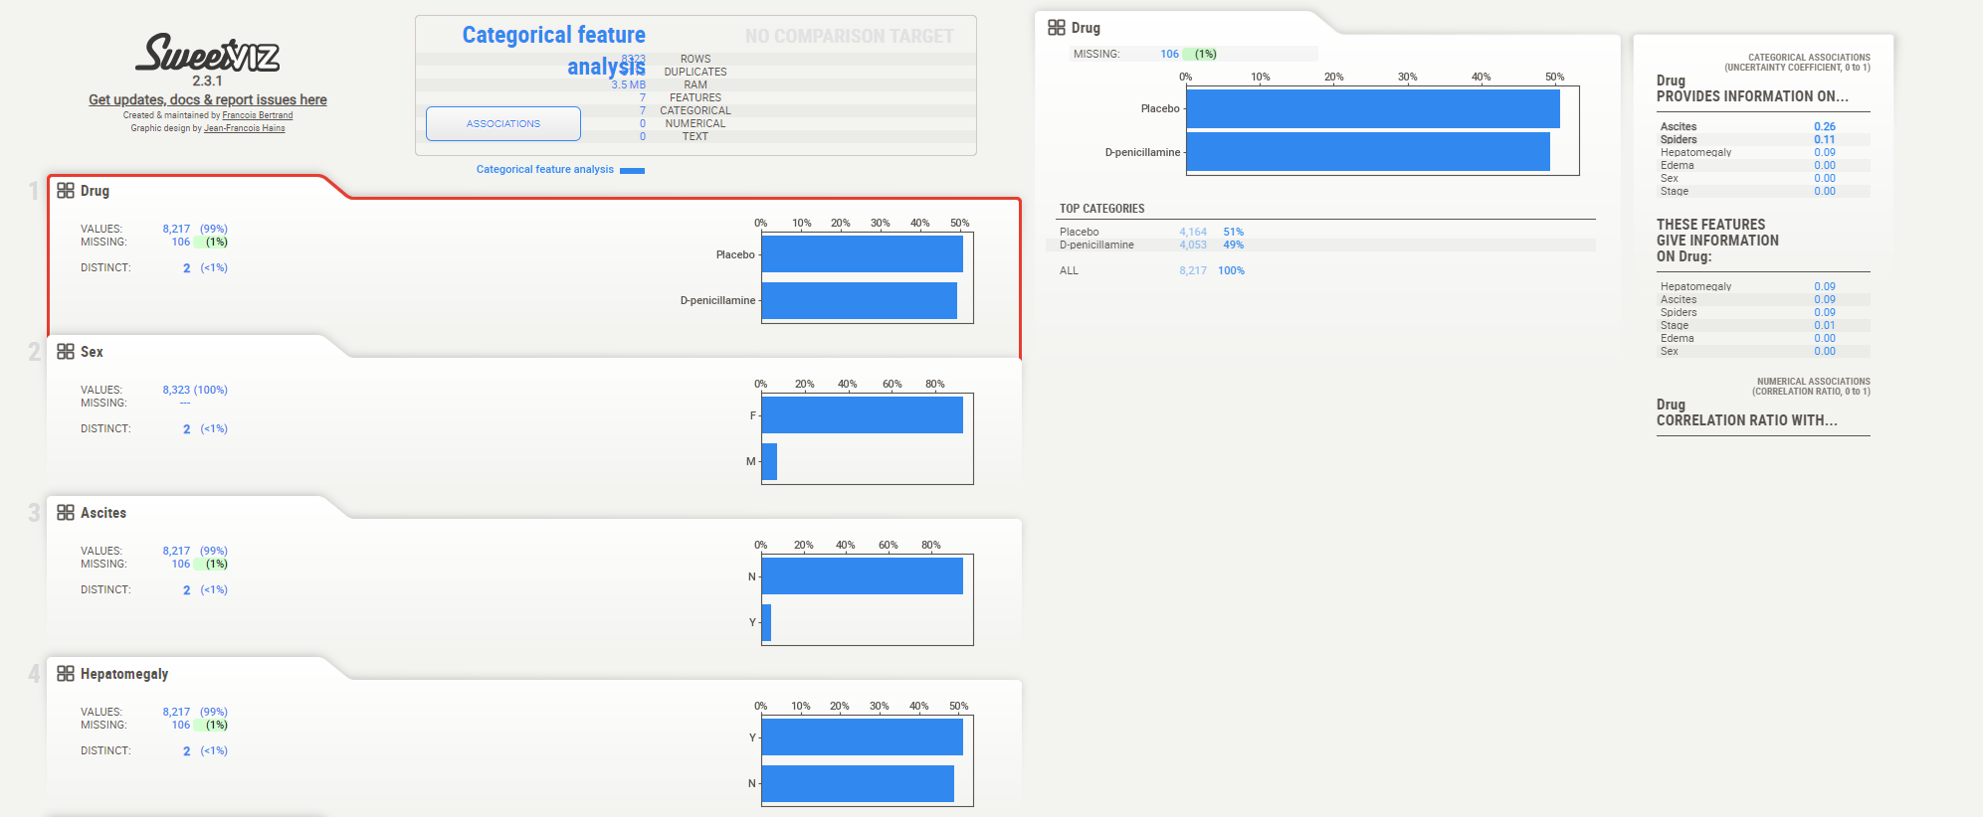
EDA - Univariate Analysis
Using the integrated dataset, we initiated an exploration of its diverse facets to gain deeper insights and determine which features could be most beneficial in predicting patient outcomes.

Slide 9
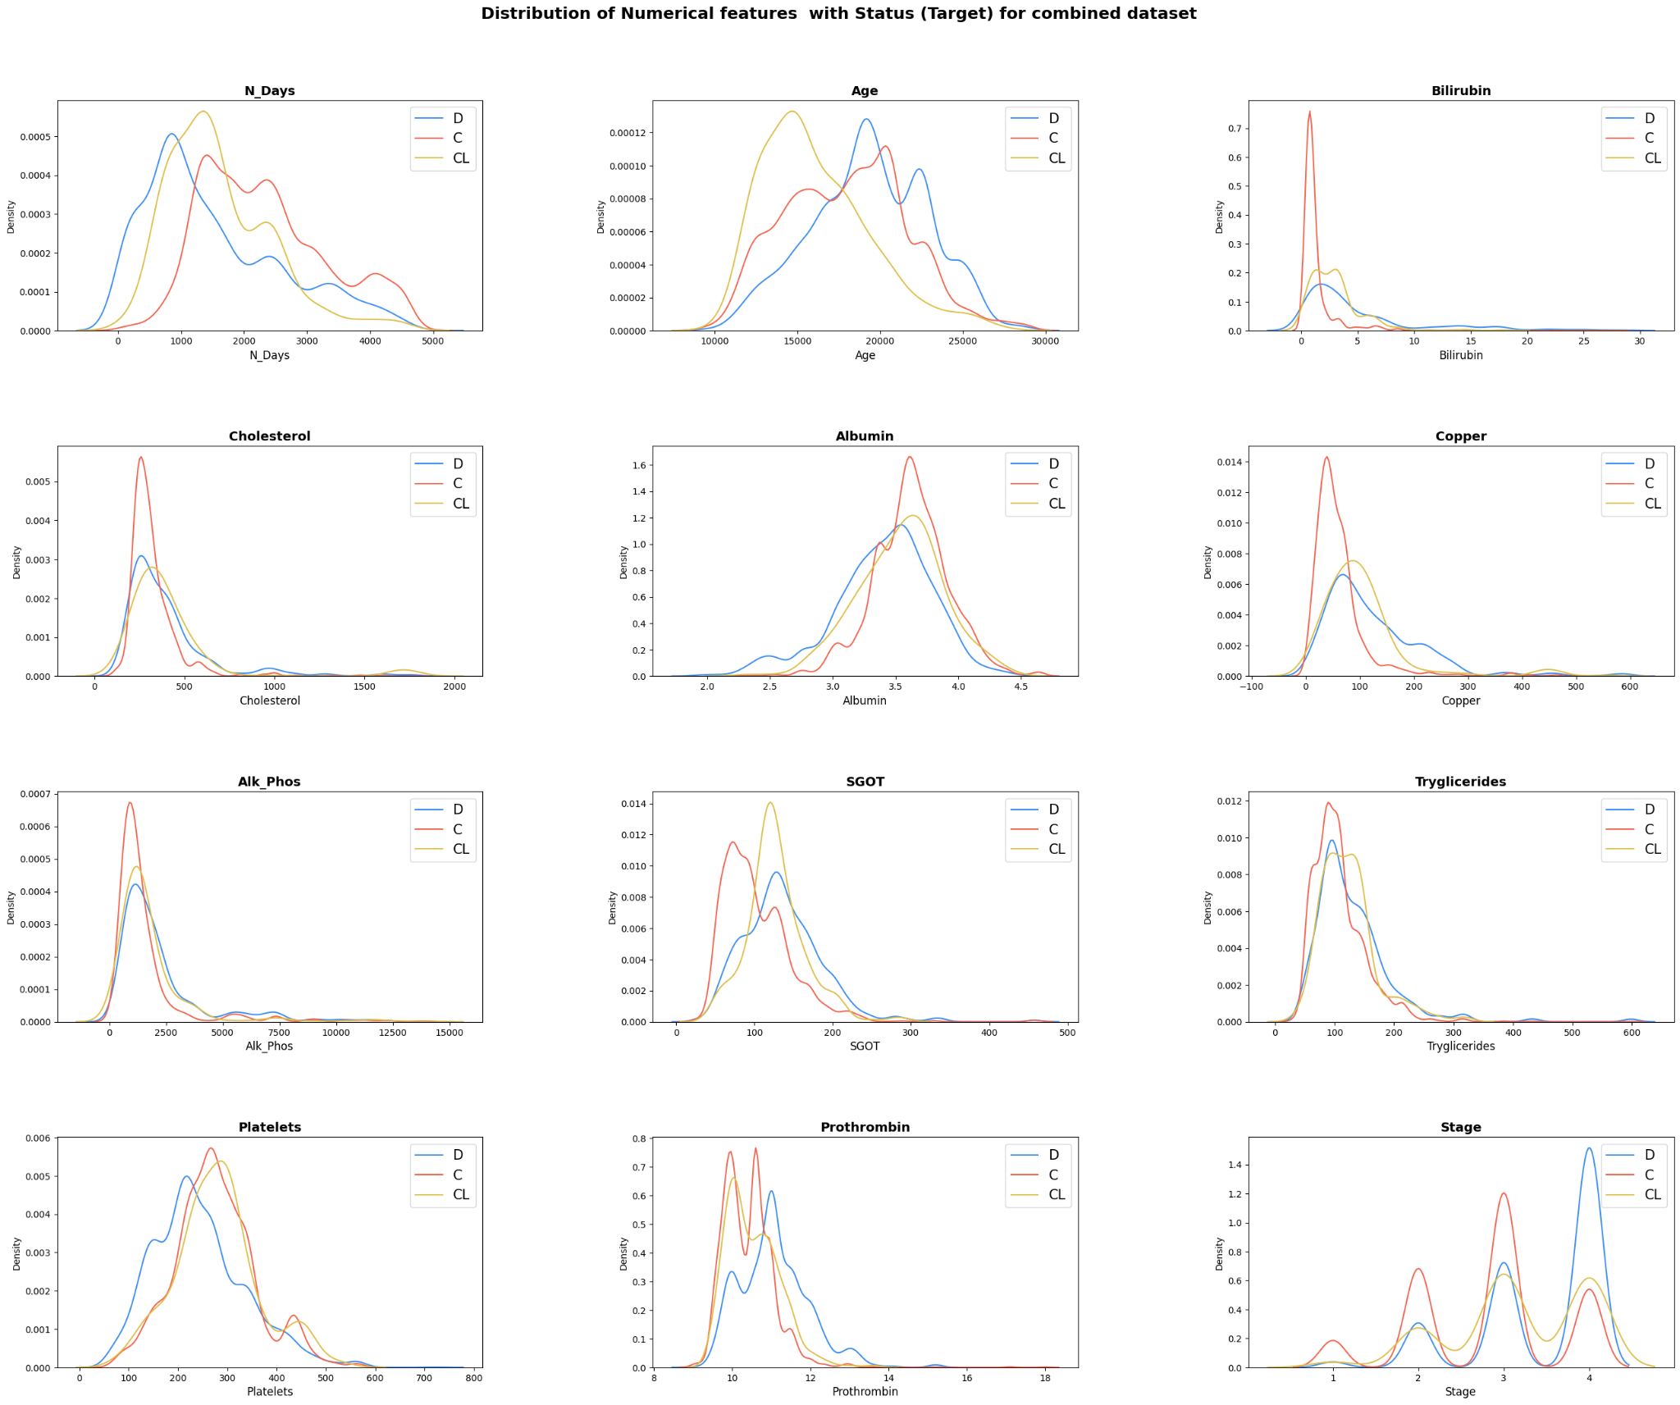
EDA: Distribution of numerical variables across output classes
Further delving into the analysis, we examined the distributions of various features across different classes to identify potential patterns unique to specific output classes that could be utilized in the modeling process.

Slide 10
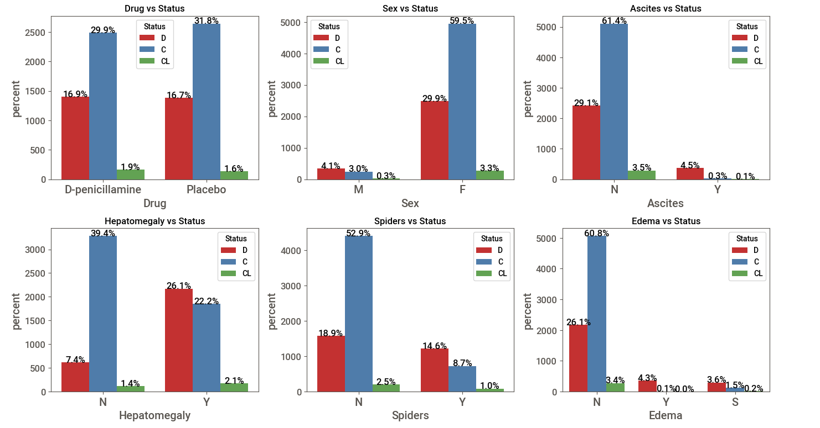
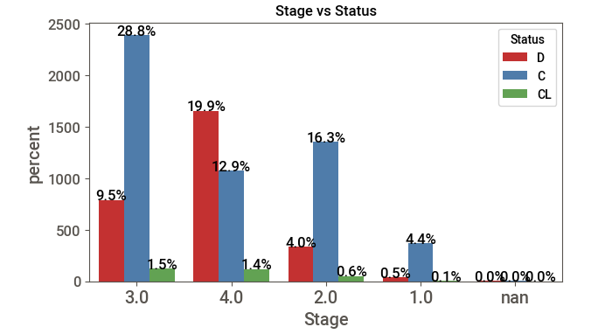
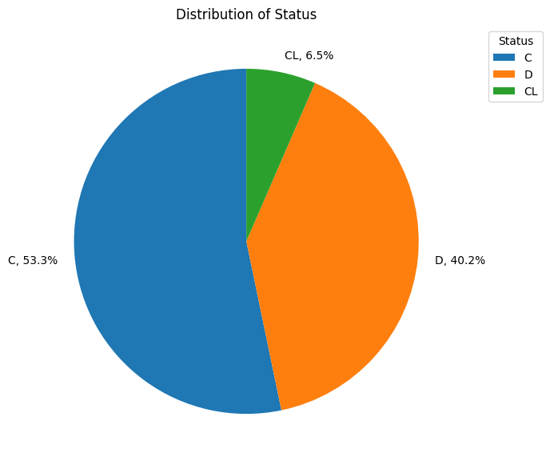
EDA: Distribution of categorical variables across output classes and output class distribution

Slide 11
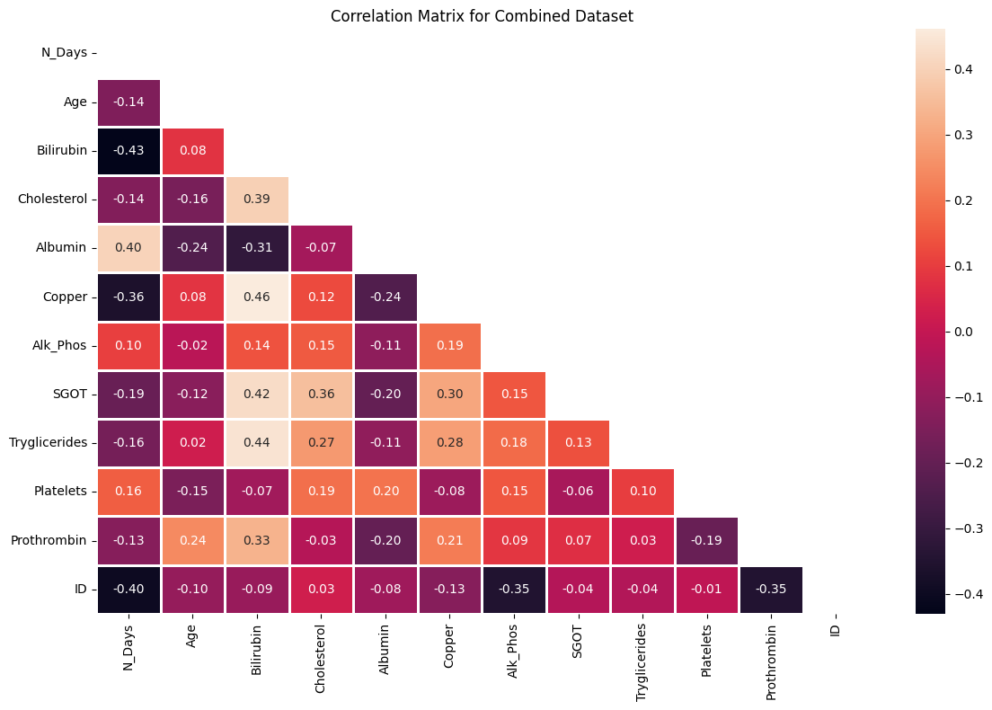
EDA - Correlation and statistical significance
None the variables are highly correlated. Hence, cannot discard any of them.

Slide 12
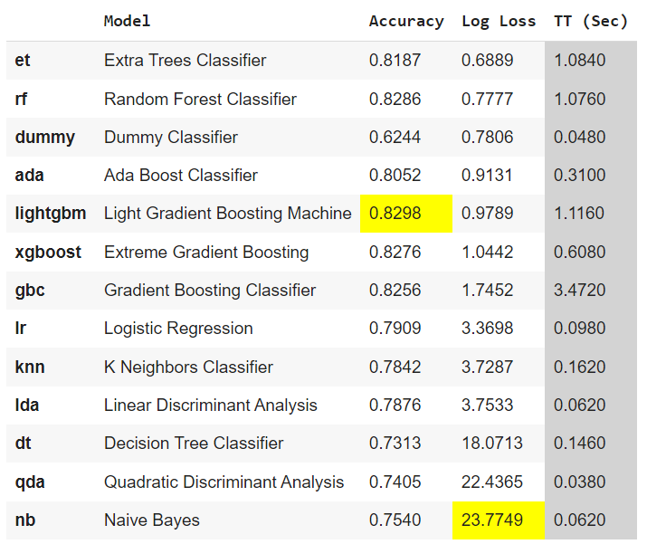
Baseline Models: Auto ML (PyCaret)
Using pycaret we aimed to get 2 baseline models to beat with minimal preprocessing in the next set of iterations and the results of trying out various models and their metrics are summarized here
We have used stratified k-fold throughout for cross validation during baseline ML model development and in the next set of iterations to ensure that the percentage of samples across different output classes are maintained
Log loss has been used as the primary metric throughout to evaluate the models during both phases

Slide 13
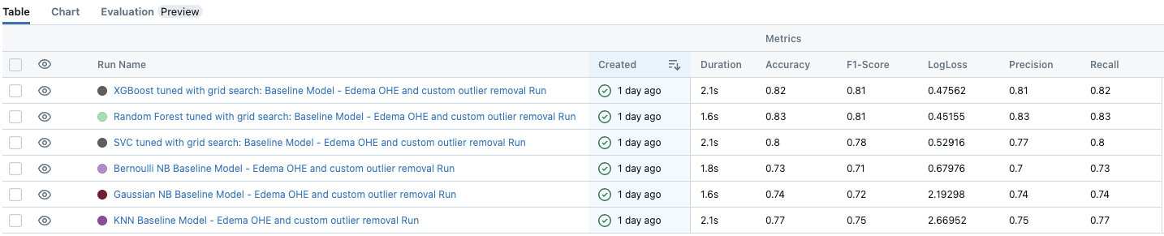
Iteration 1 - ML Flow V3
Replace the image with the ML Flow Log of V3
Use the scatter plot image (ed color) for this
Preprocessing Steps:
Categorical Encoding
One-hot: Edema col.
Ordinal: All other col.
Scaling Technique
MinMax Scaler
Custom Outlier removal
Selective Capping Approach
Preprocessing Steps:
Custom Outlier removal
Selective Capping Approach

Slide 14
Iteration 2 - ML Flow V5
Preprocessing Steps:
Categorical Encoding
One-hot: All col.
Ordinal: Target col.
Scaling Technique
MinMax Scaler: Age, N_days
Robust Scaler: Rest all col.
Hyperparameter Tuning
hyperopt
Replace the image with the ML Flow Log of V5

Slide 15
Iteration 3 - ML Flow V6
Replace the image with the ML Flow Log of V6
Preprocessing Steps:
Categorical Encoding
One-hot: Edema col..
Ordinal: Target col.
Scaling Technique
MinMax Scaler: Age, N_days
Robust Scaler: Rest all col.
Hyperparameter Tuning
hyperopt

Slide 16
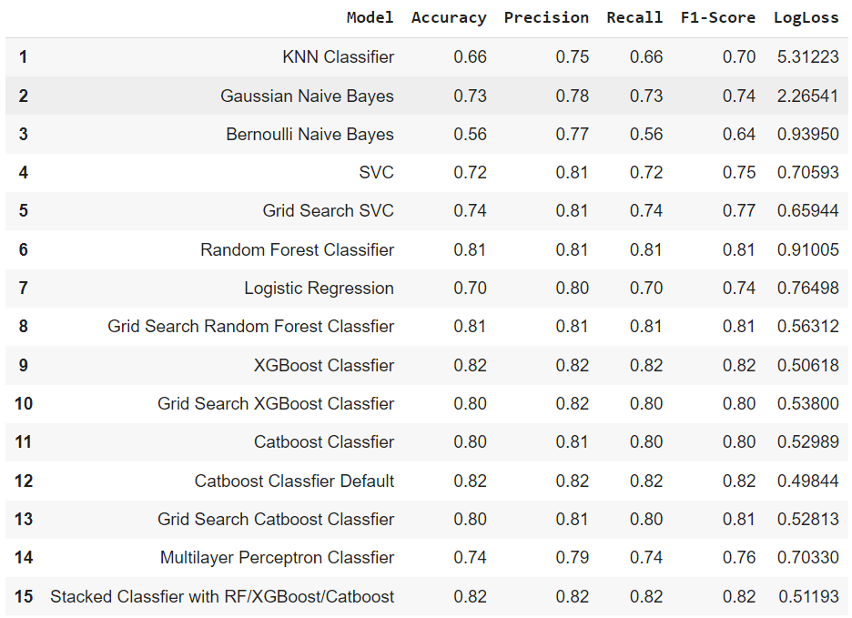
Iteration 4 - ML Flow V7.1
Replace the image with the ML Flow Log of V7.1
Use the mission plot distribution for this
Preprocessing Steps:
Missing Value Imputation
Numerical: KNN Impute
Categorica: Mode Impute
Categorical Encoding
One-hot: All col.
Ordinal: Target col.
Scaling Technique
MinMax Scaler: Age, N_days
Robust Scaler: Rest all col.
Hyperparameter Tuning
hyperopt

Slide 17
Iteration 5 - ML Flow V7.2 = V6
Replace the image with the ML Flow Log of V7.2
Check with Abishek on what’s the difference between V6 and V7.2
Preprocessing Steps:
Categorical Encoding
One-hot: Edema col..
Ordinal: Target col.
Scaling Technique
MinMax Scaler: Age, N_days
Robust Scaler: Rest all col.
Hyperparameter Tuning
hyperopt

Slide 18
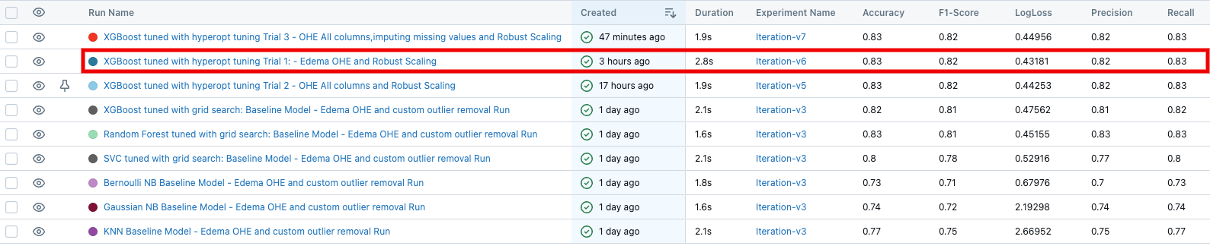
Iteration 6(Best model)
Preprocessing Steps:

Slide 19
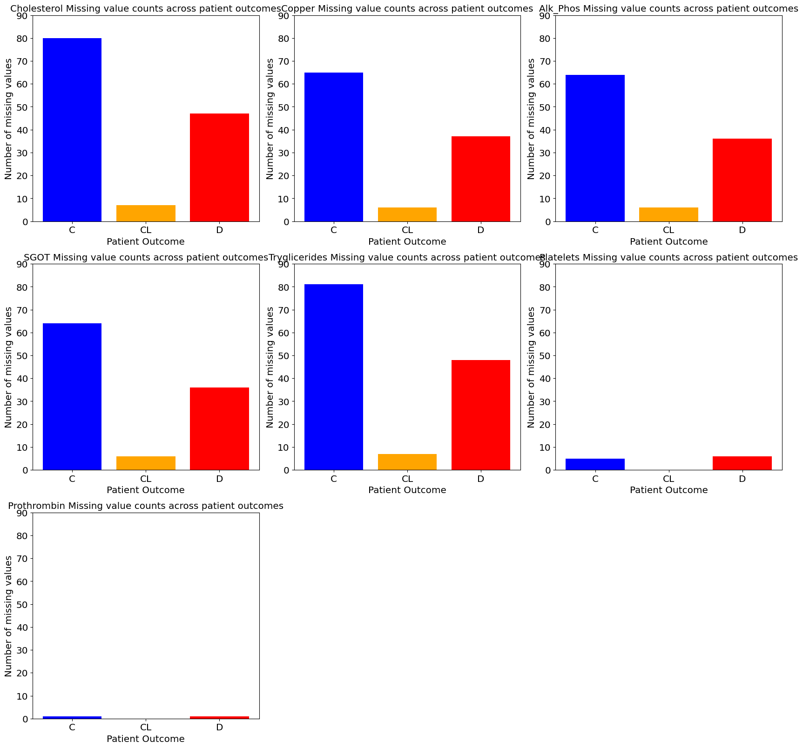

Slide 20
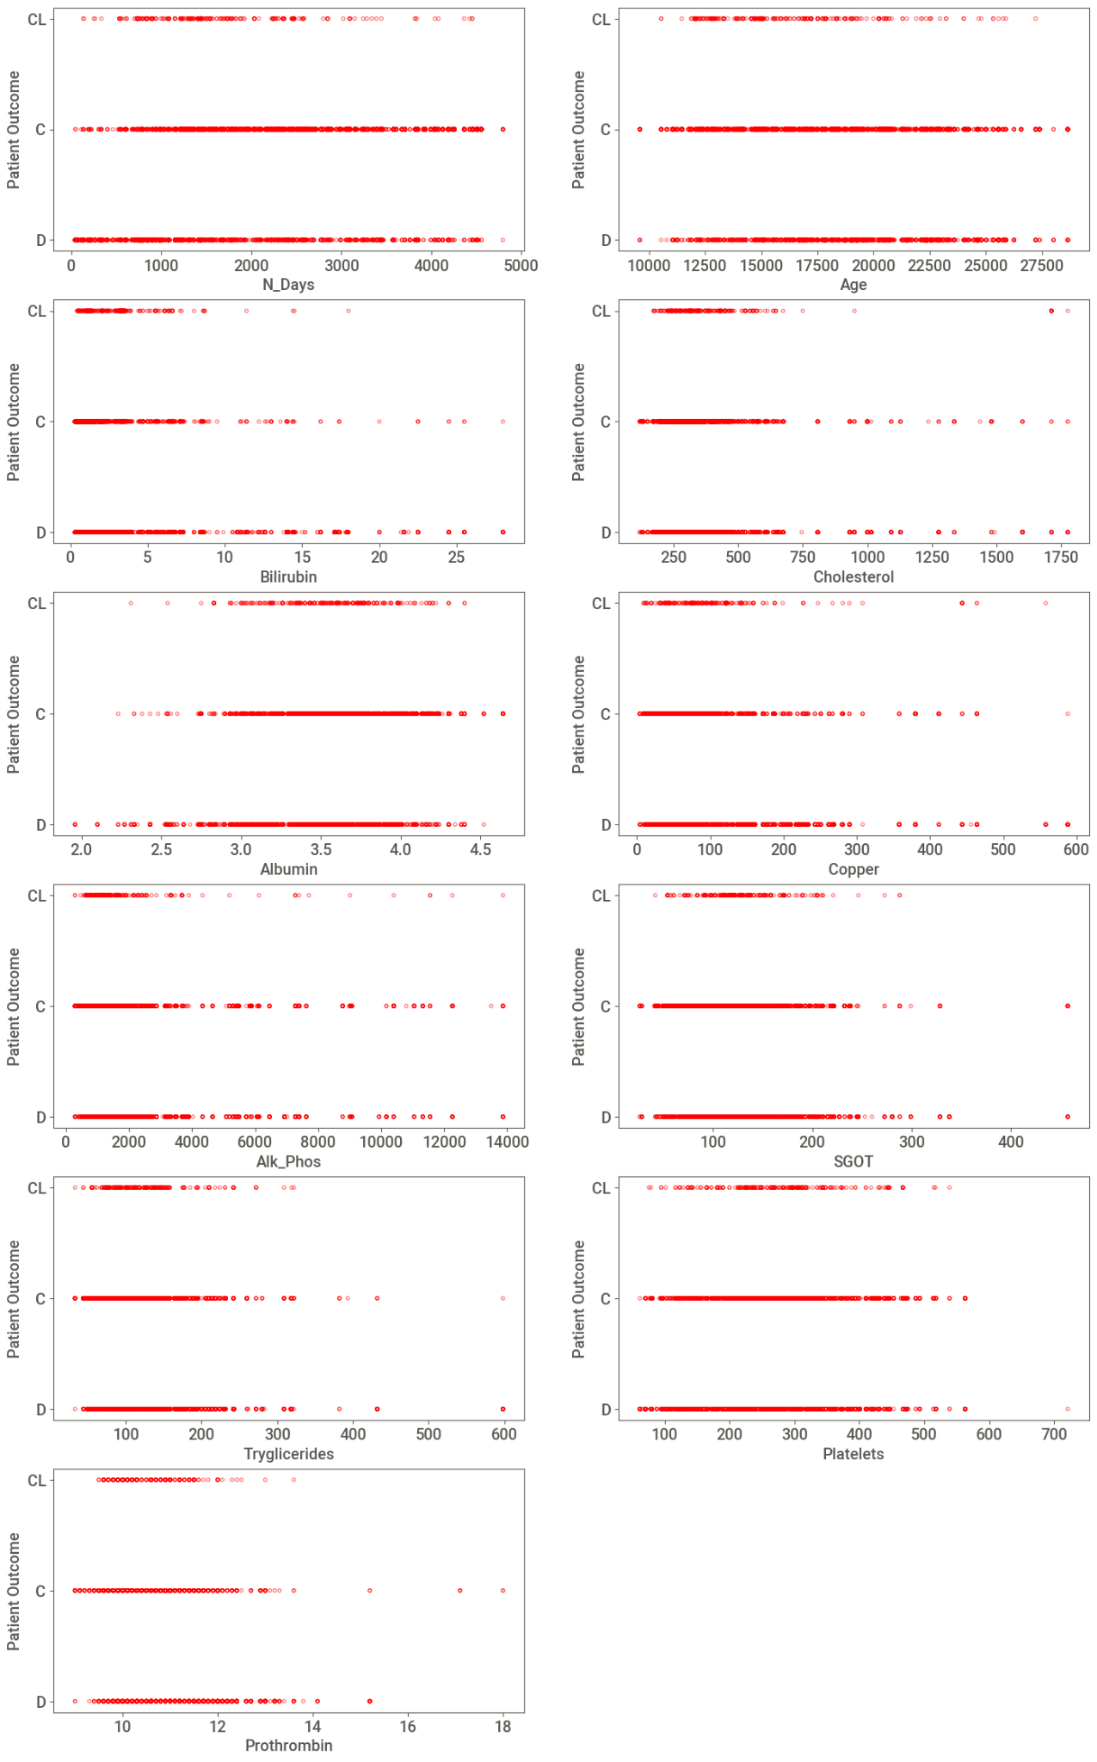

Slide 21
Managerial Actions:

